Slide 1
PROGRAMMING FOR SMART CONTRACTS PROJECT
N V SAI VIVEK
2100030375
SEC-21

Slide 2
QUESTION
Write a contract that implements find the greatest common divisor (GCD) of two numbers.

Slide 3
STEPS
STEP 1:WRITE THE SOLIDITY CODE IN REMIX IDE AND COMPILE IT
STEP 2: ADD THE GANACHE NETWORK TO METAMASK NETWORK
STEP 3: ADD REMIX IDE WITH METAMASK
STEP 4:DEPLOY THE SOLIDITY CODE IN METAMASK
STEP 5:ANALYZE THE CHANGES OCCURED

Slide 4
STEP 1:THE CODE
// SPDX-License-Identifier:MIT
pragma solidity ^0.8.14;
contract GCDFinder {
function findGCD(uint256 a, uint256 b) external pure returns (uint256) {
require(a > 0 && b > 0, "Numbers must be greater than zero");
while (b != 0) {
uint256 temp = b;
b = a % b;
a = temp;
}
return a;
}
}

Slide 5
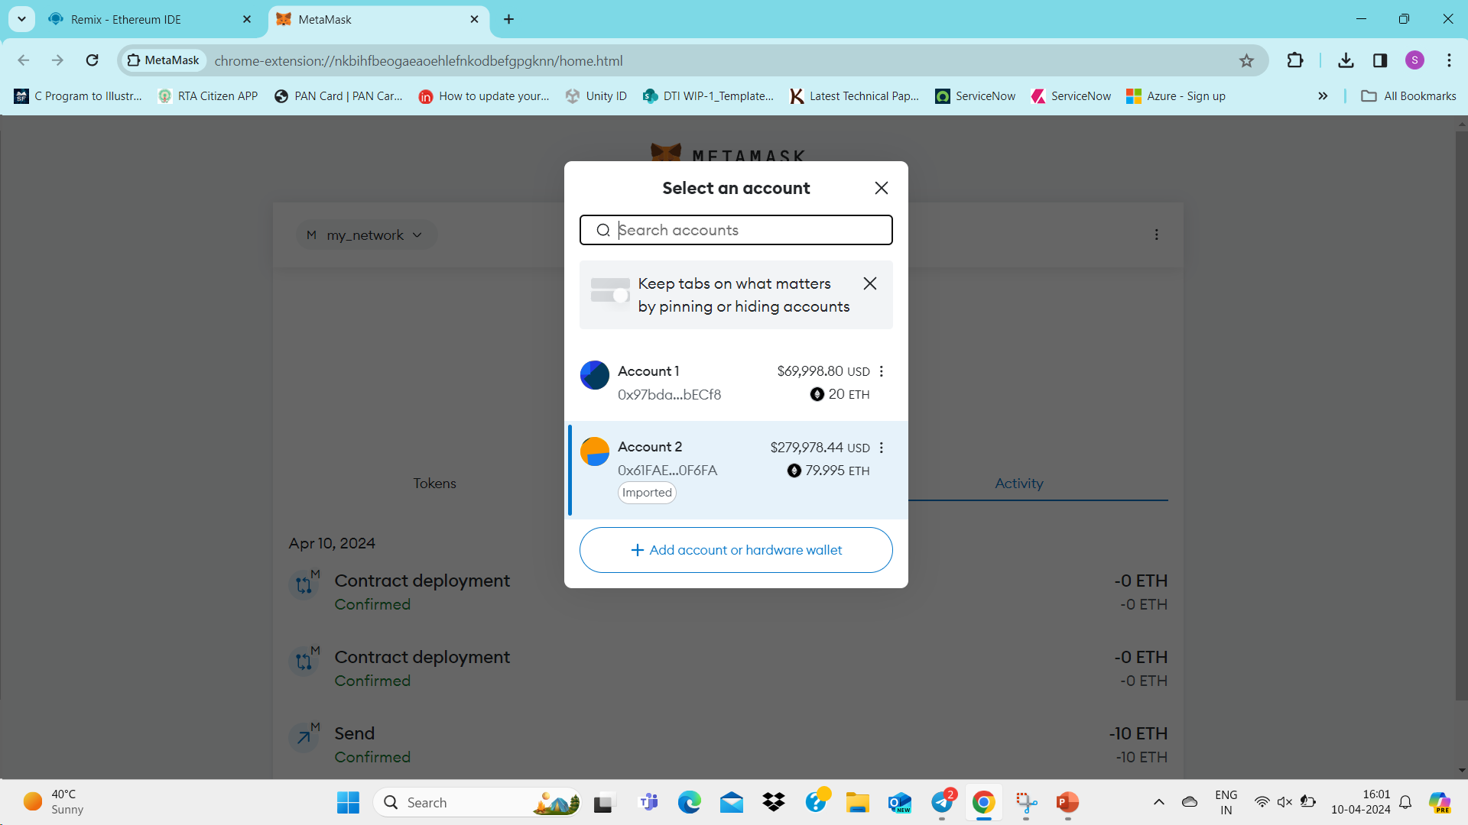
STEP 2

Slide 6
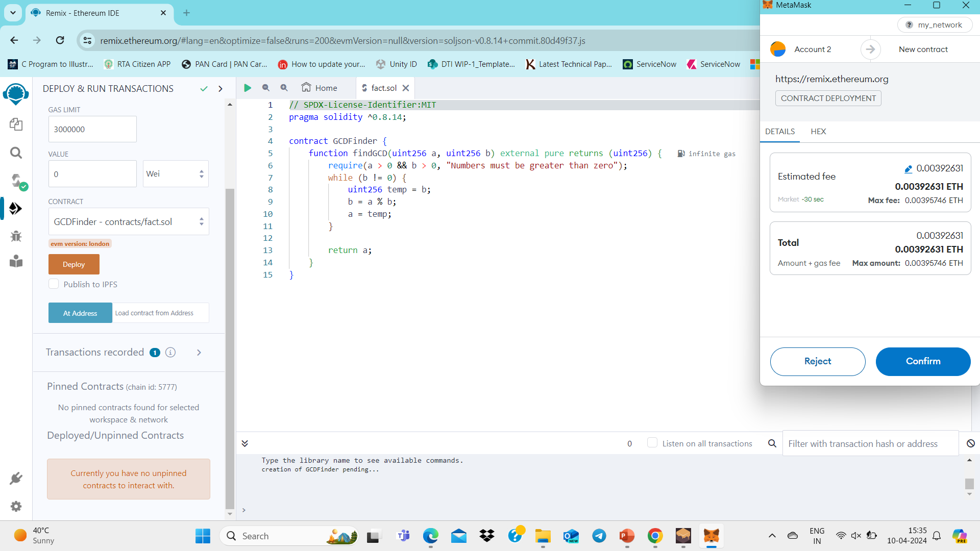
STEP 3

Slide 7
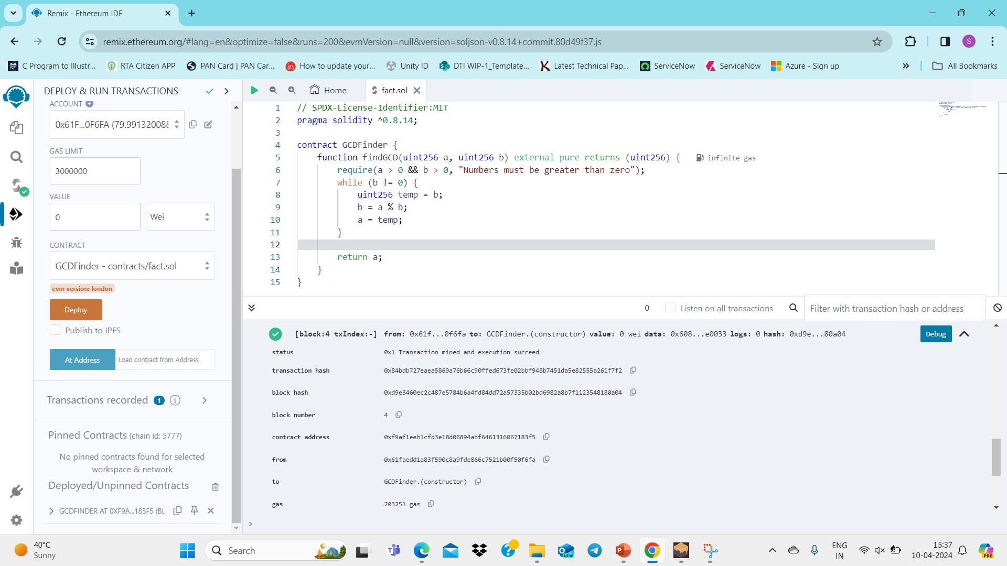
STEP 4

Slide 8
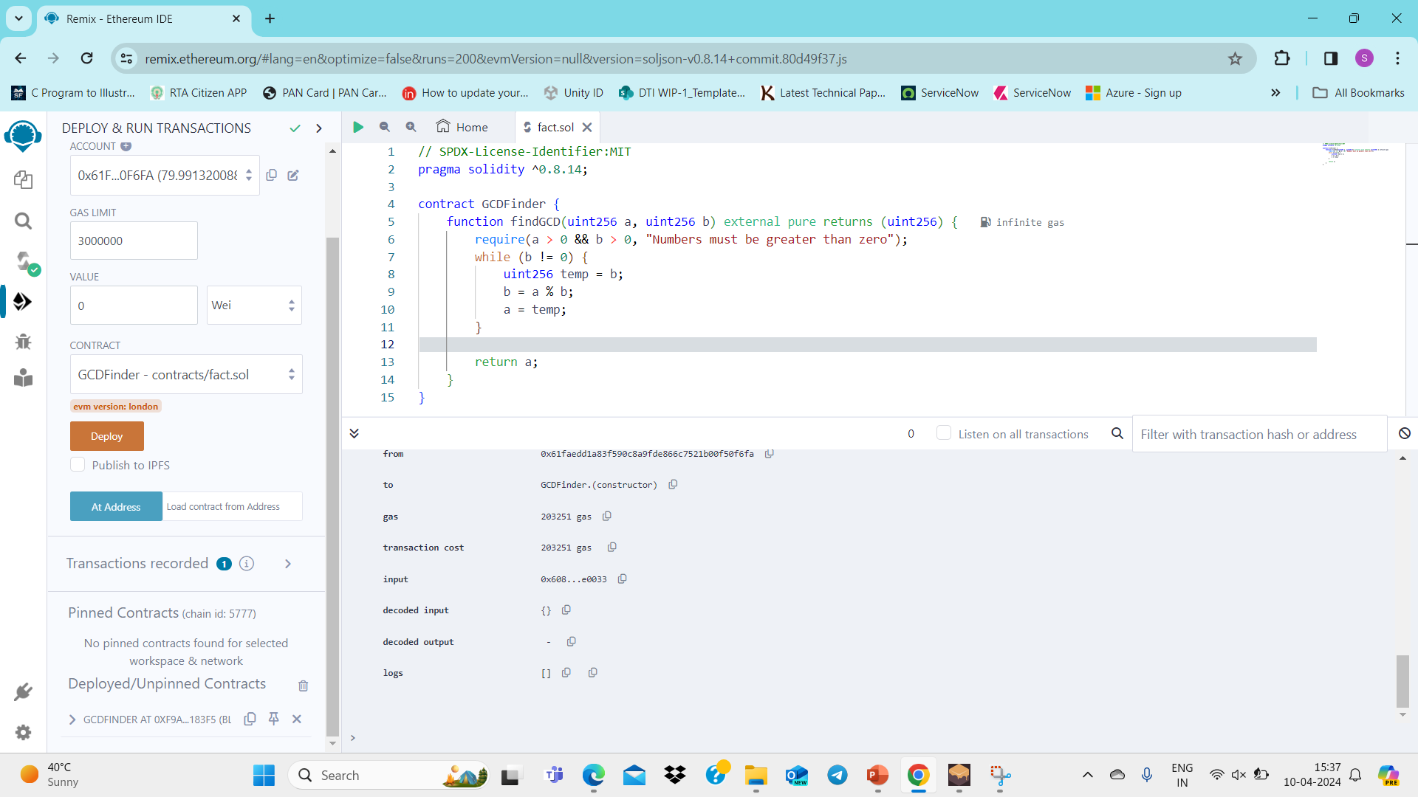
STEP 5

Slide 9
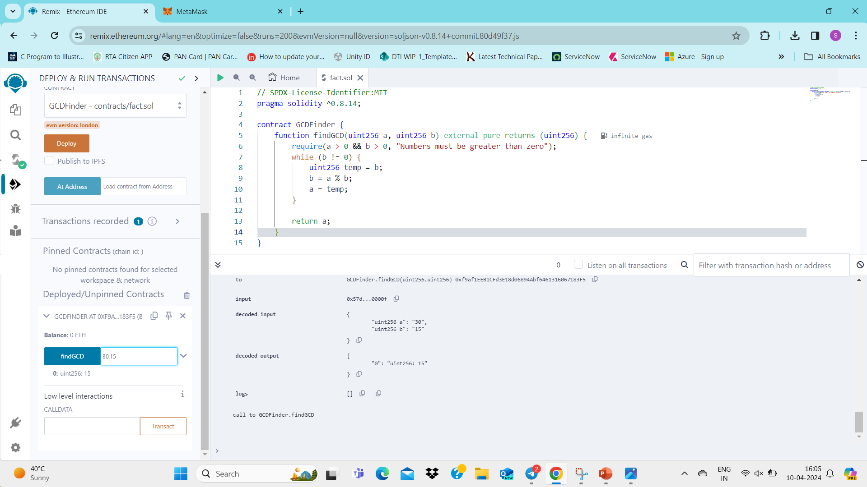
STEP 6

Slide 10
REFERENCE VIDEO PROCESS
FOR VIDEO PLEASE GO TO THE BELOW GIT HUB REPOSITORY AND WATCH THE VIDEO:
https://github.com/saivivek08/GCD_SC_Blockchain

Slide 11
GIT HUB REPOSITORY LINK
https://github.com/saivivek08/GCD_SC_Blockchain

Slide 12
CONCLUSION
BY FOLLOWING THE ABOVE STEPS,SCREENSHOTS,VIDEO AND THE GIT HUB REPOSITORY LINK WE CAN GET A CLEAR IDEA OF COMPLETEING THE PROJECT SUCCESSFULLY

Slide 13

THANK YOU

